Slide 1
Employee Data Analysis using Excel
STUDENT NAME: JAGADEV K
REGISTER NO: 312214516 (086FA0D6EE051DFBB3A4DC59DBFA16A0)
DEPARTMENT: B.COM (COMPUTER APPLICATION)
COLLEGE: ST.THOMAS OF ART&SCIENCE COLLEGE

Slide 2
PROJECT TITLE
USING PIVOT TABLES FOR EMPLOYEE TURNOVER ANALYSIS

Slide 3


AGENDA
Problem Statement
Project Overview
End Users
Our Solution and Proposition
Dataset Description
Modelling Approach
Results and Discussion
Conclusion
3/21/2024 Annual Review

Slide 4

PROBLEM STATEMENT
*The Human Resources department is experiencing challenges in understanding and managing employee turnover within the organization.
*Current methods of data analysis are insufficient in identifying key trends and patterns related to turnover, such as which departments, job roles, or demographic groups are most affected. This lack of insight hampers the ability to develop targeted retention strategies.

Slide 5

PROJECT OVERVIEW
Employee turnover is a critical issue for organizations, affecting productivity, morale, and financial performance. Understanding the factors contributing to turnover is essential for developing effective retention strategies.
This project aims to leverage pivot tables to analyze employee turnover data, providing insights into patterns and trends that can inform decision-making within the Human Resources (HR) department.

Slide 6

WHO ARE THE END USERS?
Human Resources (HR) Team:•HR Analysts: Responsible for conducting the analysis and presenting the findings.HR Managers: Interested in understanding the turnover trends to implement strategic initiatives.
2.HR Directors and Executives:•HR Directors: Oversee the overall HR strategy and need the insights to align turnover management with organizational goals.•Chief HR Officer (CHRO): Utilizes the data to guide company-wide HR policies and strategies
3.Executives and Senior Management:•CEO/CFO: Interested in the financial and

Slide 7

OUR SOLUTION AND ITS VALUE PROPOSITION
Streamlined Data Organization: - Pivot tables allow you to consolidate and organize large volumes of HR data efficiently. - Simplifies the process of categorizing turnover data by departments, roles, tenure, and other key metrics.
2. Dynamic Analysis Capabilities: - Enables easy filtering and sorting of data to identify patterns, trends, and anomalies in employee turnover. - Allows for quick adjustments and comparisons, such as turnover rates by department, time period, or employee demographics.
4. Cost-Effective Solution:* - Uses widely available tools (Excel, Google Sheets) that require minimal additional investment. - Reduces the need for expensive third-party analytics software or consultants.

Slide 8
Dataset Description
*Kaagle- employee dataset
*26 feature
*9 features
*Emp id- numerical
*Fn- text
*Ln-text
*Business unit- text
*Gender- male, female
*Perfromnaace score- text
*Rating- numerical(5,4,3,2)

Slide 9

THE "WOW" IN OUR SOLUTION
The "Wow" Factor in Our Solution for Using Pivot Tables for Employee Turnover Analysis
Instant Actionable Insights:* *Wow:* Our solution turns raw HR data into immediate, actionable insights with just a few clicks. Pivot tables allow you to dynamically interact with data, uncovering turnover trends and patterns that might otherwise be missed.
2. User-Friendly and Intuitive:* - *Wow:* No need for advanced technical skills—anyone familiar with basic spreadsheet functions can use this tool. The simplicity and ease of use make it accessible to all HR professionals, regardless of their
3/21/2024 Annual Review
9

Slide 10
MODELLING
*Analyzing employee turnover using pivot tables involves organizing and summarizing data in a way that makes it easier to identify patterns, trends, and insights. Below is a step-by-step guide to modeling this analysis.
*Step 1: Prepare Your DataBefore using a pivot table, ensure your data is structured properly. Your dataset should include at least the following columns:-
*(e.g., resignation, termination, retirement).Status Whether the employee is currently employed or has left (e.g., "Active", "Terminated").
10

Slide 11
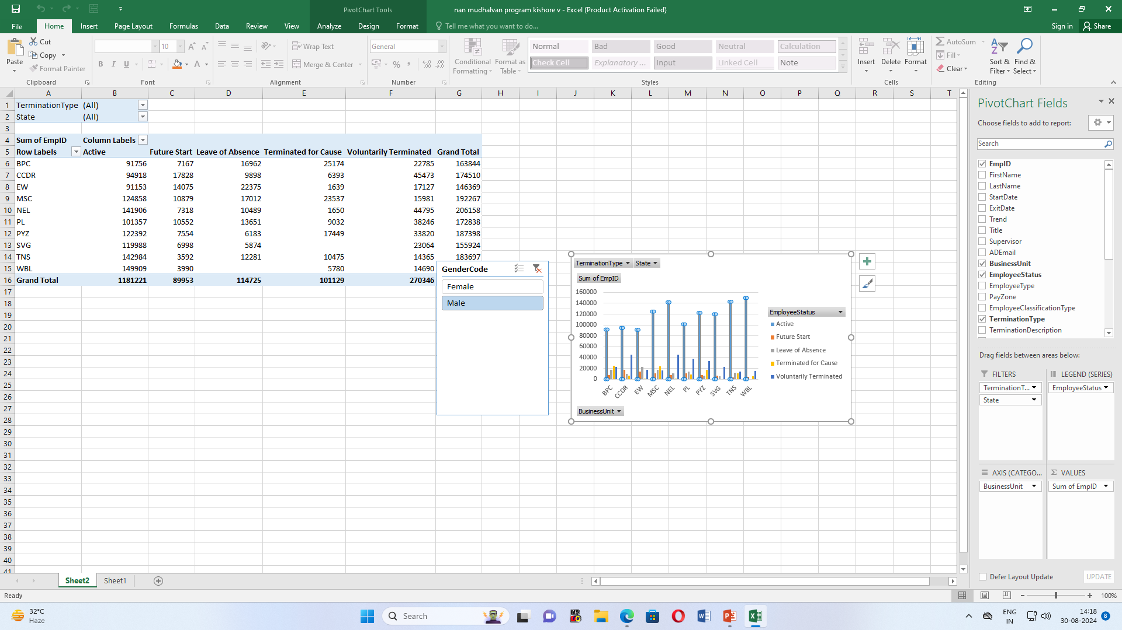
RESULTS
11

Slide 12
conclusion
*In conclusion, pivot tables are a powerful tool for analyzing employee turnover, providing a clear and concise way to summarize and interpret complex data.
*They allow for efficient organization and visualization of turnover metrics, such as rates by department, reasons for leaving, and tenure trends.
*This analytical approach ultimately supports data-driven decision-making, helping to create a more resilient and effective organization.

